Slide 1
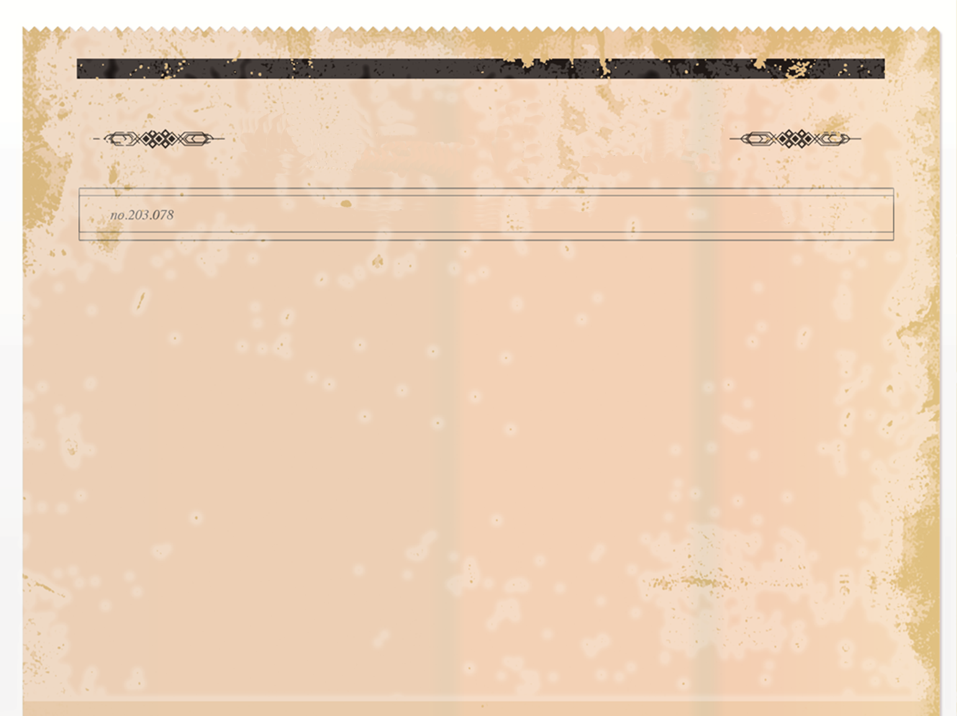
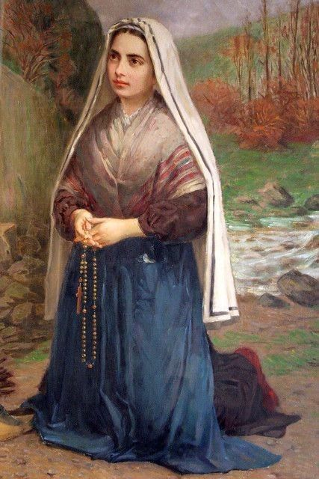
The SAINT REVIEWER
The Catholic’s favourite newspaper
April 16th 1979
-
Saint Bernadette – Her life – 100 Year Anniversary
100 years ago, today Saint Bernadette known as the humble Saint died. Today in The Saint Reviewer we are celebrating her life.
Saint Bernadette was born on the 7th of January 1844.She was one of nine children. Unfortunately, she was born into a very poor family, she was very poorly and suffered from asthma. Bernadette usually stayed at home helping her mother to do chores and looking after her brother and sisters.
Bernadette commented when she was older “I was nothing and of this nothing God made something great”.
So now let’s look a little closer at how Bernadette became who she is known as today.
In 1858, aged 14, Bernadette was about to receive her First Holy Communion, when she had her first vision. When she saw the vision Bernadette began praying.
When she told her friend and sister, they said they had seen nothing. She also told them not to tell anybody, but Bernadette’s sister told their mother. She told Bernadette to stop daydreaming and commanded them not to go to the place where she saw the lady again.
I
“I shall spend every moment loving.”
7/1/1844
- 16/4/1879
A painting of Saint Bernadette praying to the vision.

Slide 2
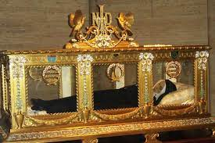
The SAINT REVIEWER
The Catholic’s favourite newspaper
April 16th 1979
-
More visions..
January 18th 1862
On this date the Church announced Bernadette’s visions “authentic and supernatural”. Interestingly she never returned the Grotto once the visions had stopped.
1866 – Sisters of Charity and Nevers
When Bernadette was 22, she joined a nunnery, the Sisters of Charity and Nevers. The rest of her life was dedicated to praying and helping others in the hospital.
100 years ago, today on April 16th, 1879, she died of Tuberculosis, sadly she was only 35 years old.
Finally, Bernadette’s mother gave her permission to visit the Grotto. To Bernadette’s surprise she saw the lady 17 more times that year. The lady spoke to Bernadette and said that she would have happiness not in this world but in the next.
March 25th – Feast of the Annunciation
On this day, the sixteenth visit she told Bernadette who she really was, she said that she was the Immaculate Conception, The Virgin Mary. It was reported that this was the last time she spoke to Bernadette.
Saint Bernadette’s body in a glass casket.
“Jesus gives all to those
who surrender all.”
Nobody believed Bernadette when she told them about her 17 visions, people were unkind to her. Bernadette didn’t give up and still believed she had seen the vision despite what people said.

Slide 3
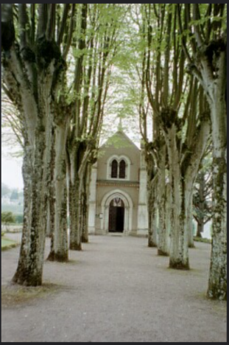
The SAINT REVIEWER
The Catholic’s favourite newspaper
April 16th 1979
-
70 years ago…
Visiting Saint Bernadette
If you would like to visit Saint Bernadette’s body it is displayed in the Chapel of Saint Gidard at the Sisters of Charity in Nevers. This is the convent where Saint Bernadette spent her last 9 years.
At her feet is a statue of the Virgin Mary.
Although many people go to see her body many people also go on a pilgrimage to Lourdes where she was born. About 6 million people a year visit Lourdes, her place of birth.
Written by Elora Hughes.
Saint Bernadette’s body was exhumed three times (1909, 1919 and 1925). In 1925 she was moved to a crystal casket. When she was dug up the first time her body was almost perfect, they call this incorrupt. Her rosary had rusted, and her habit was in shreds. Her liver , teeth and fingernails were perfect which is amazing.
Pope Pius XI
Pope Pius X1 beatified Bernadette on June 14th, 1925 and made her a Saint on December 8th, 1933 .
Saint Bernadette is remembered for trust and humility and perseverance in suffering. She is Patron Saint of Shepherds and Shepherdesses and of people who are humiliated for their beliefs.
The Convent where Saint Bernadette
lived for 9 years.
Feast Day
Although Saint Bernadette is remembered on April 16th in France and Canada, she is remembered on February 18th.
Saint Bernadette’s body was not shown to the public until 1925

